Slide 1
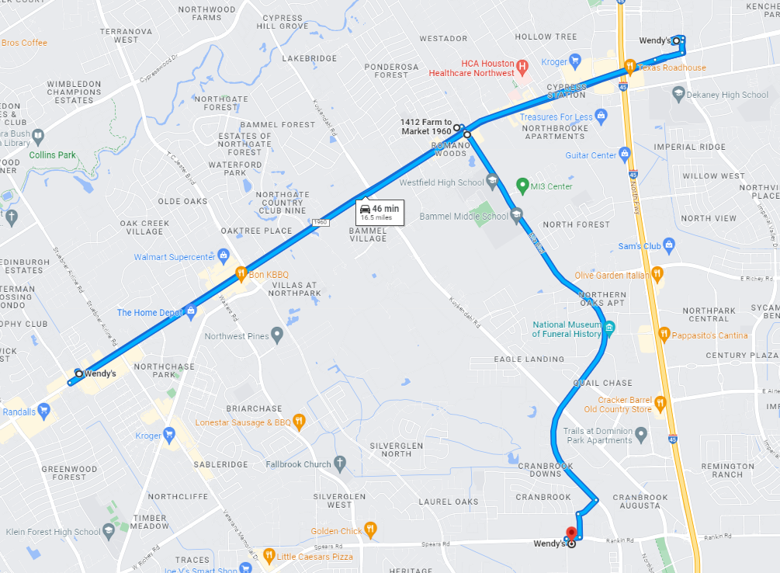
Harris County Sheriff’s Office
Crime Analysis and Intelligence Division
5749 S. Loop E. Houston, TX 77033
713-274-6240
Law Enforcement Sensitive // Official Use Only
HCSO Agg Robbery Case
Executive Summary:
CAID was tasked with linking robberies involving a black male wearing a Wendy’s uniform to HCSO Agg Robbery case which occurred at ****, Boost Mobile Store on ****. A narrative search was conducted in RMS for all Robberies and Agg Robberies from 1/1/2022 – 5/2/2023 using the keyword “Wendy%” and no other cases were found.
Suspect:
**** was detained in the incident wearing a Wendy’s uniform. No other robberies were discovered that had apparent links to ****. A TWC search on ***** revealed he has no history of working at any Wendy’s.
Location of Agg Robbery
Suspect Photo Placeholder
CCH Placeholder
LKA: ****
Phone: ****
Resources Checked:
RMS, CAD, DA’s Website, Gang Tracker, TXGANG, Leads Online, Clear, TLO, TWC
Disclaimer
This intelligence bulletin contains confidential information intended for authorized law enforcement and public safety personnel only. Unauthorized dissemination is prohibited. The Harris County Sheriff’s Office (HCSO) does not guarantee the accuracy or completeness of the information provided. The HCSO is not liable for any errors, omissions, or actions taken in reliance on this information. This bulletin is for informational purposes only and does not constitute legal advice. Recipients should consult with legal counsel as needed. If you received this bulletin in error, please notify the sender immediately and destroy all copies.
Date: 8/29/2024
Produced by: I. Garcia, CAID Analyst

